Slide 1
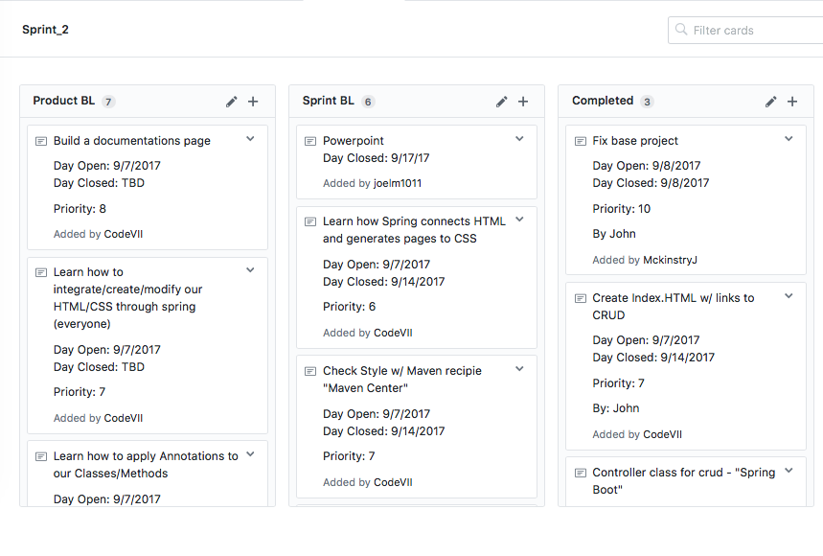
Team Four Sprint 2
Joel, Diego, John, Nick, Chris

Slide 2
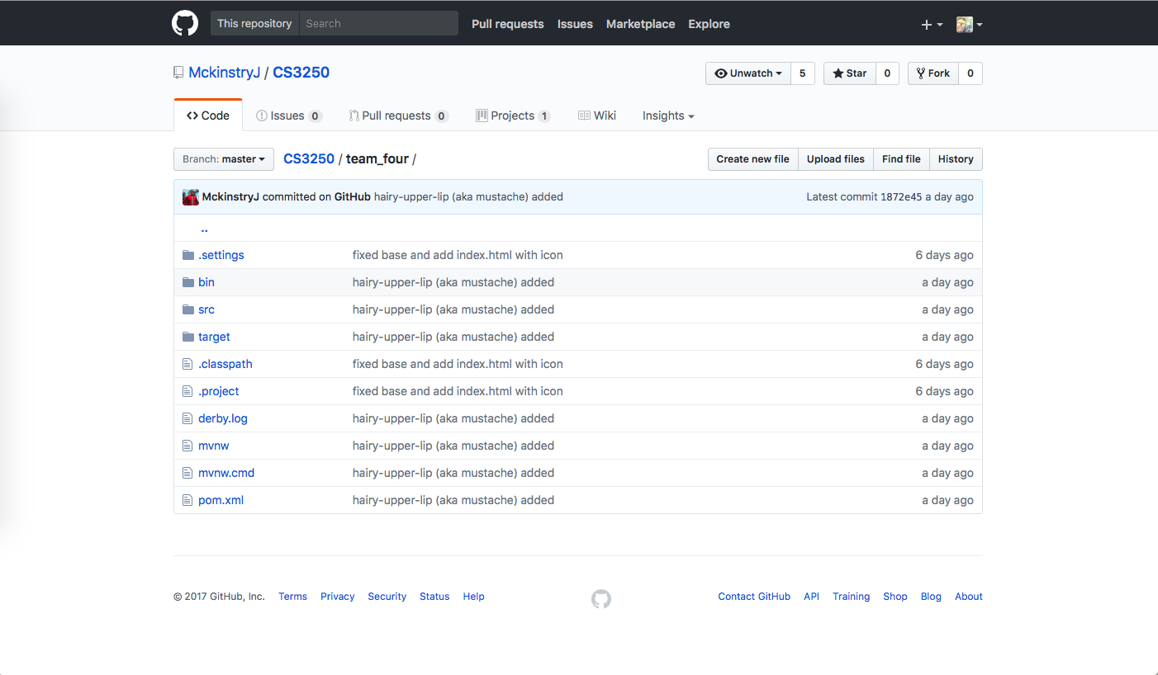
Github

Slide 3
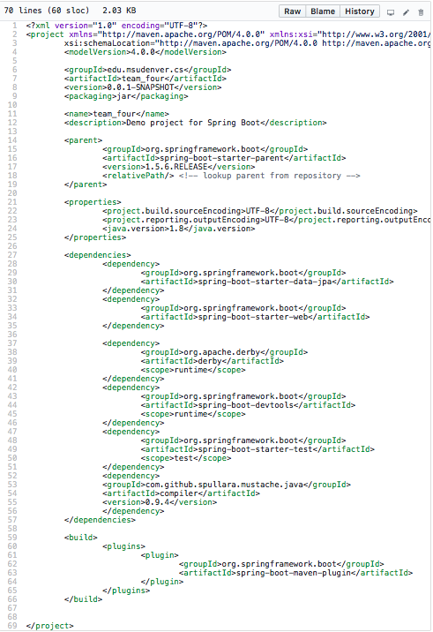
Spring Dependencies (pom.xml)

Slide 4
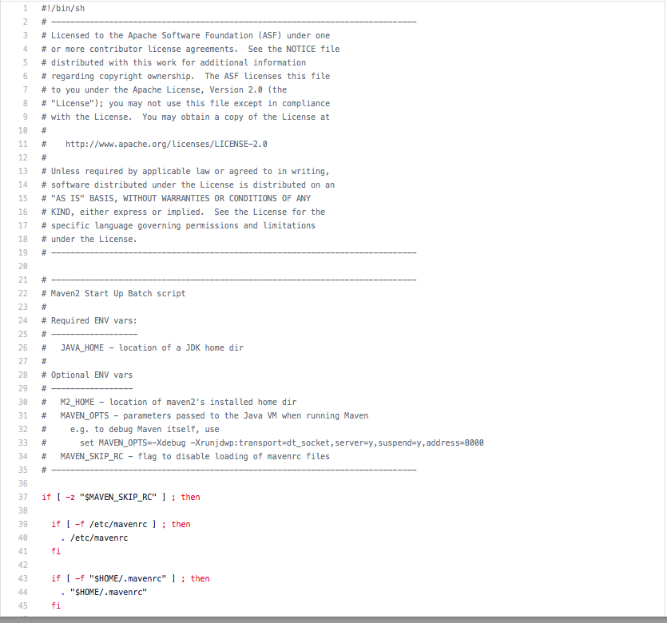
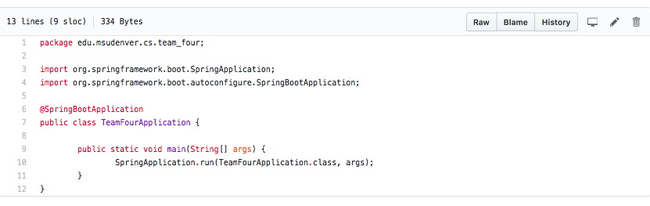
Maven license Spring Main Application

Slide 5
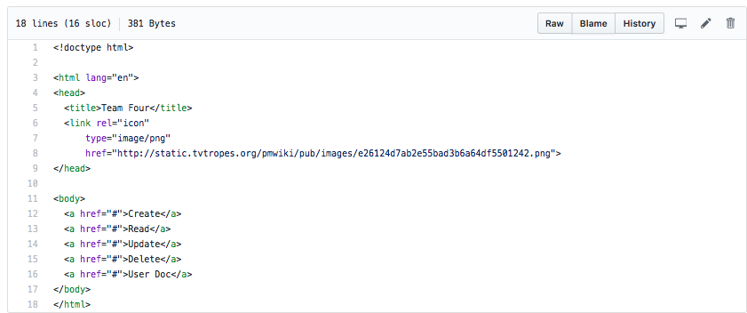
Index.html: Mustache added

Slide 6
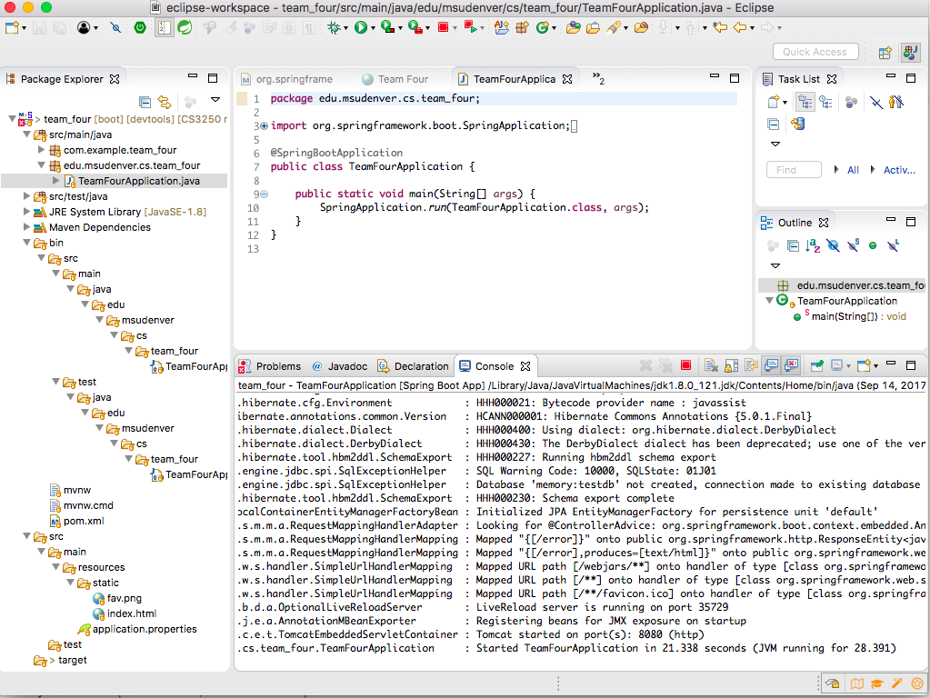
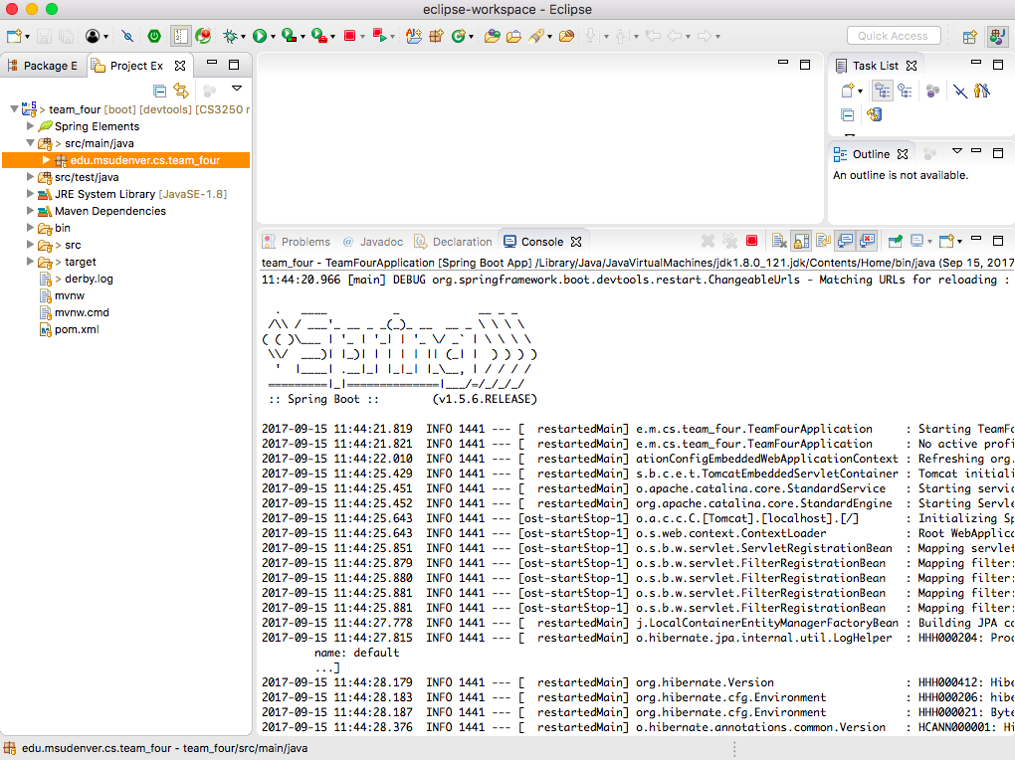
Running Spring Boot App.

Slide 7
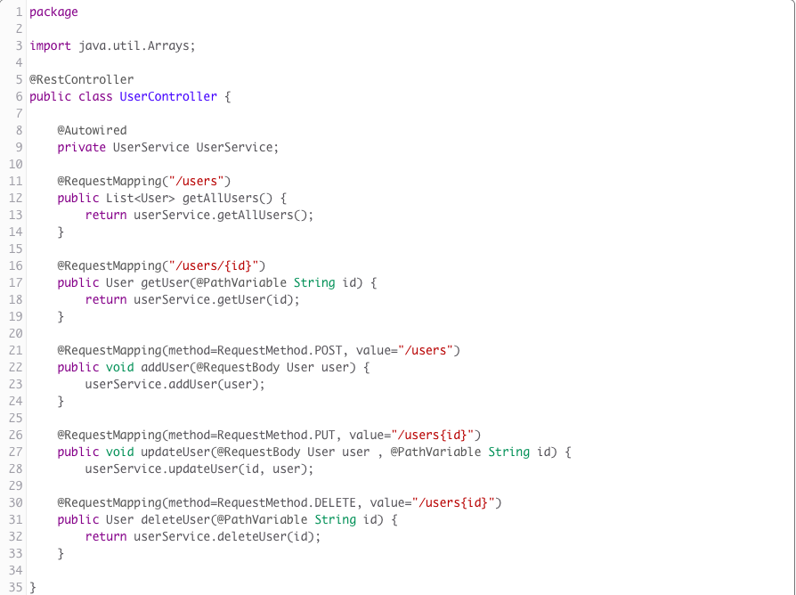
Controller Class

Slide 8
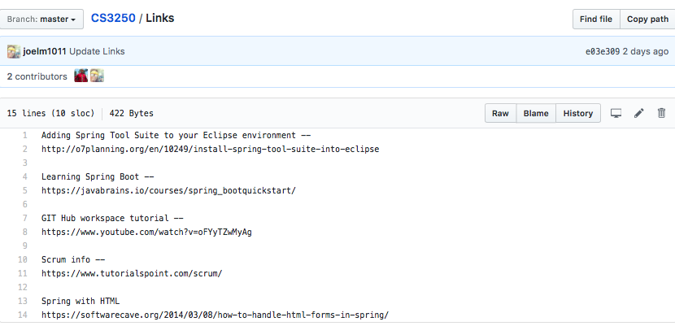

Slide 9
Retrospective
What went well
What could have gone better
What we will commit to improve

